Slide 1
Instruction of CSGO-Project
By Eric

Slide 2
Content:
In the CSGO pre-order system, you could experience the loot box system during the close beta period of this game, and also purchase other equipment in our shop!
If you wanna find some announcements about maintenance times, you can visit our forum where you will also find some introductions to this game.

Slide 3
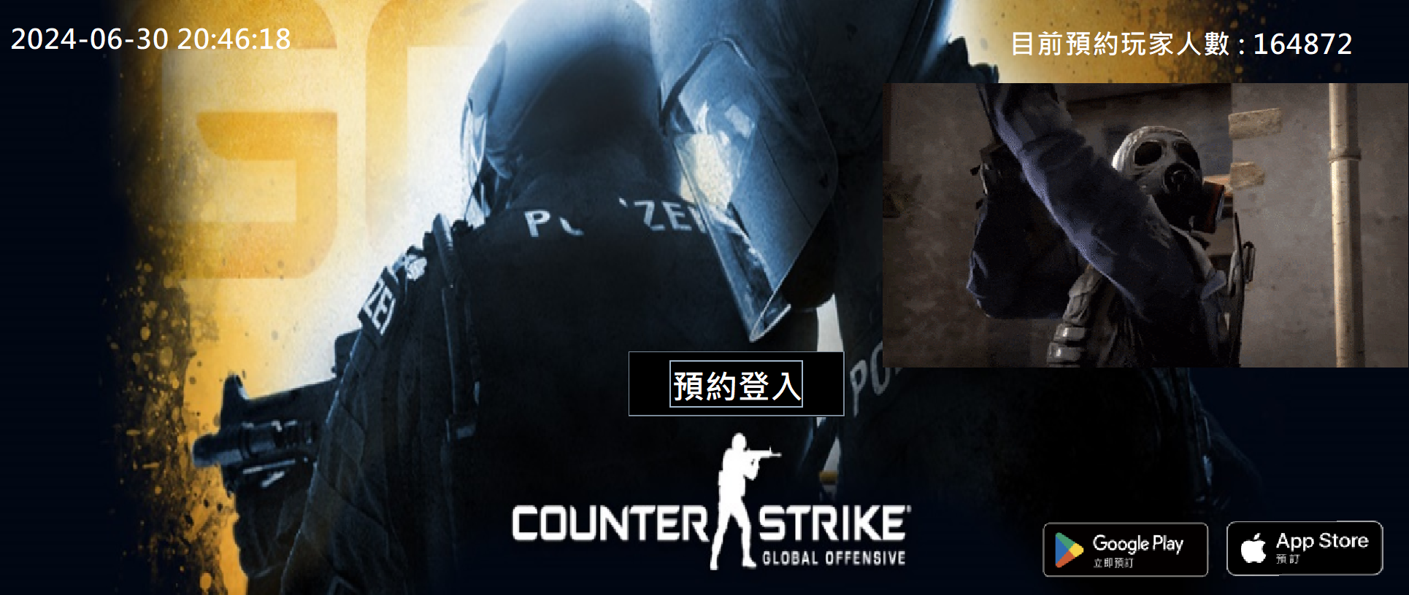
You can access our login page through any of these three buttons.

Slide 4
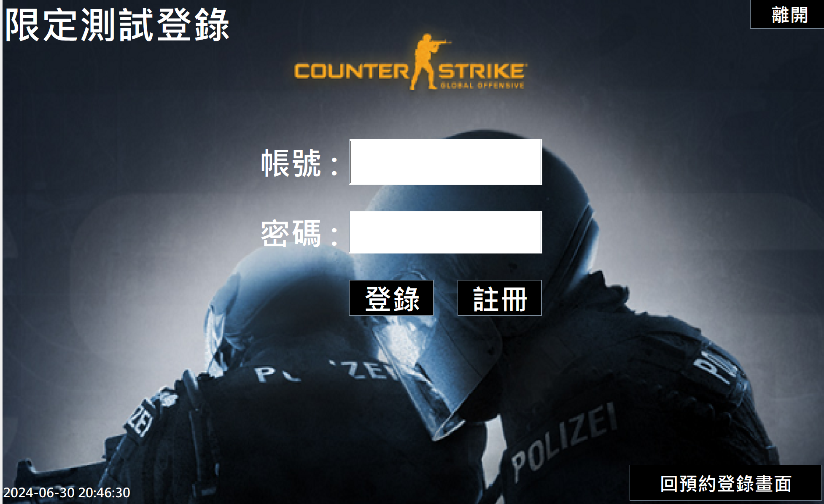
If you already have an account.
Pls enter your account and password here, then click the button” login(登陸) ”to enter this game.
If you anin’t got no account, you could click this button to register.

Slide 5
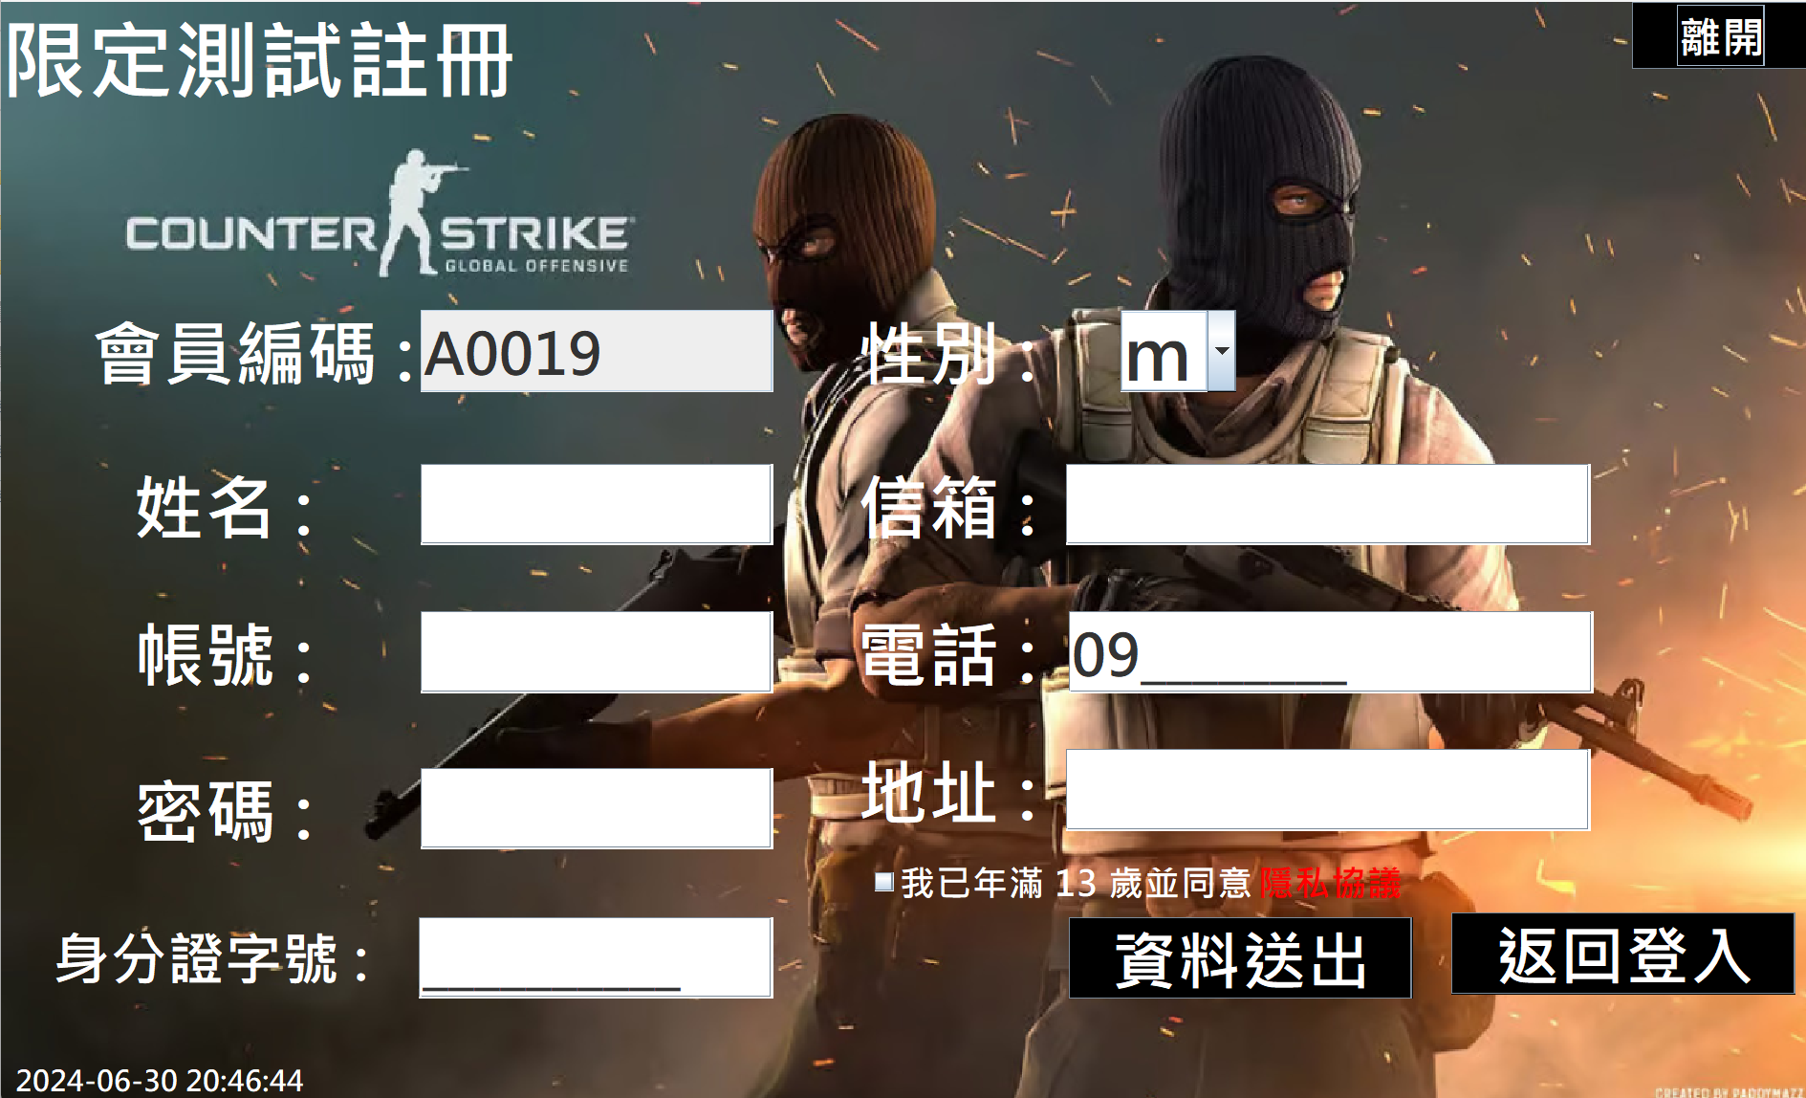
Here’s the private policy
Two steps to register:
Please fill in every field.
Review at least one time of private policy(隱私協議)
Then click : sent(資料送出)

Slide 6
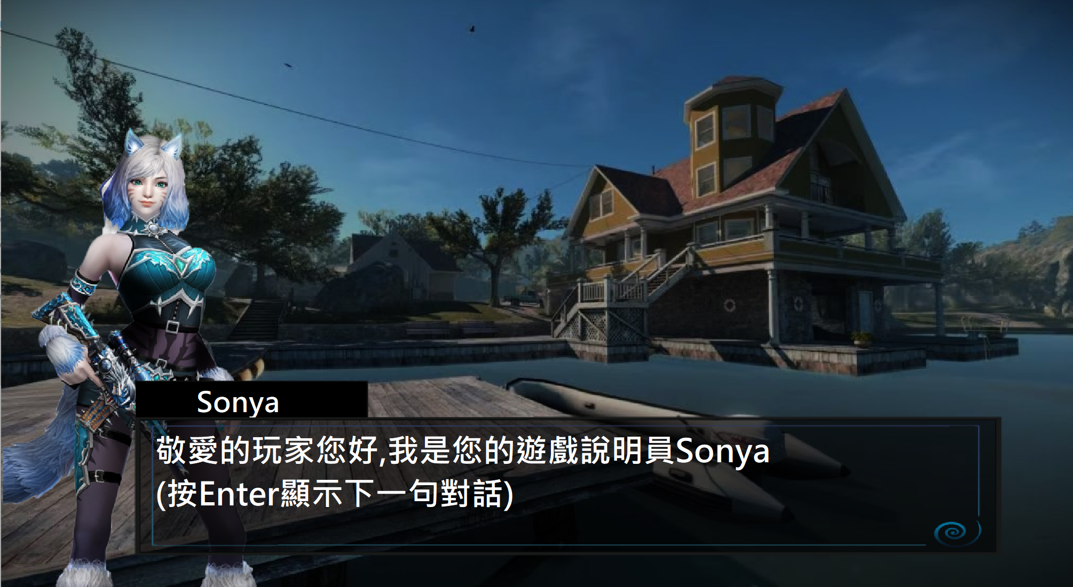
If you successfully register, you will meet our first commentator, Sonya. She will introduce some important points that players need to remember.

Slide 7
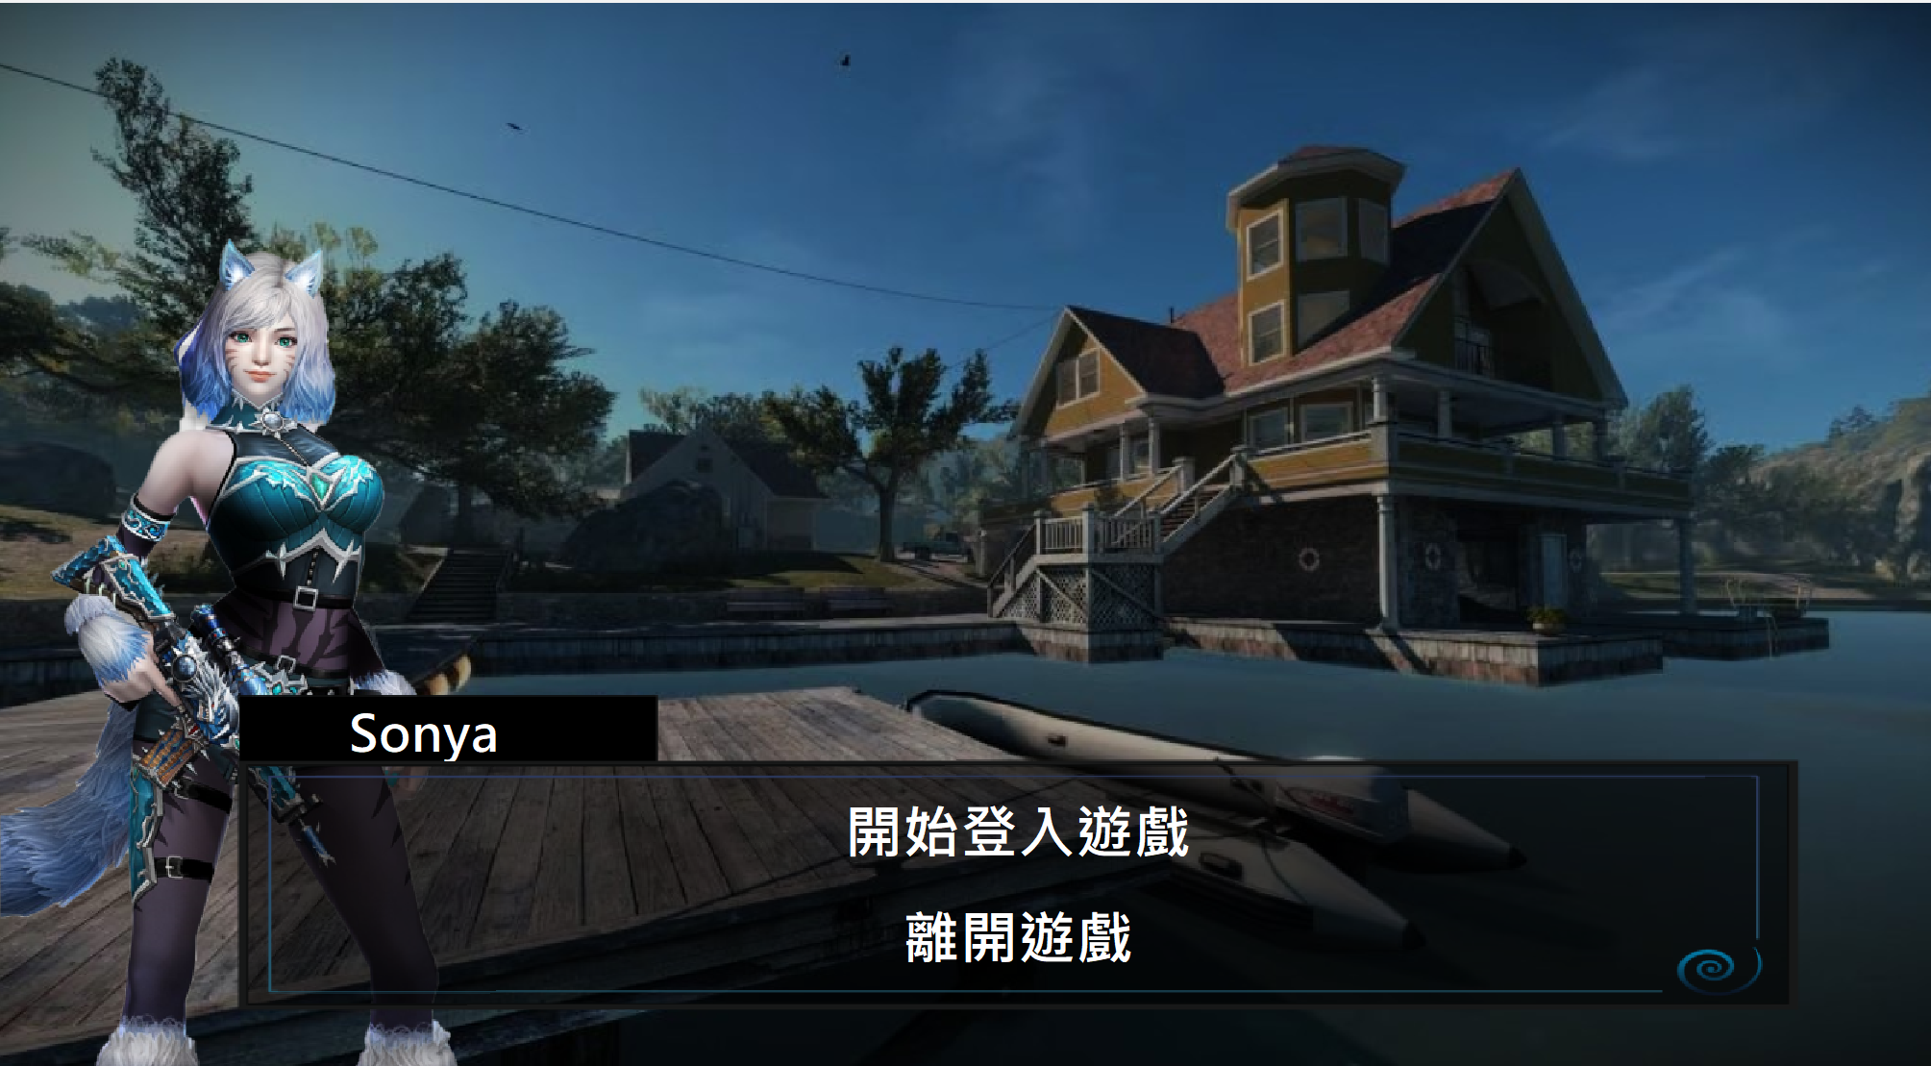
Exit the game
Back to login page

Slide 8
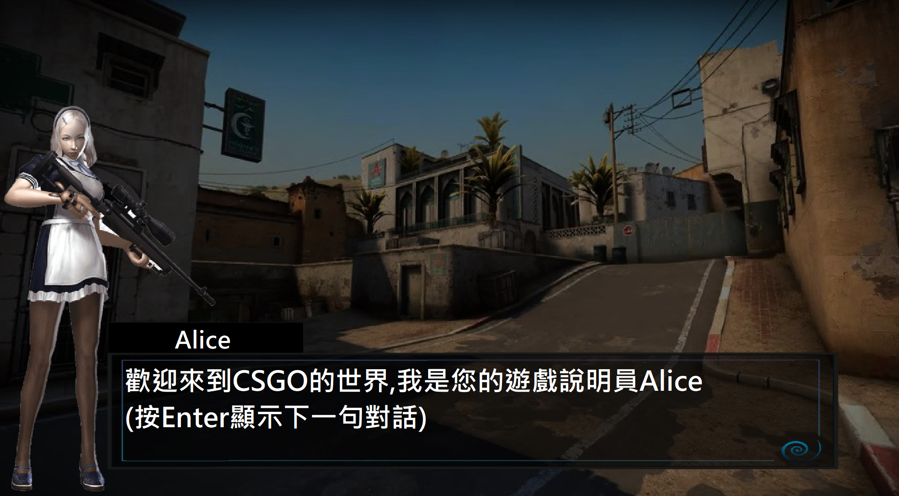
After logging in successfully, you will meet our second commentator, Alice. She will introduce the events during the closed beta of this game.

Slide 9
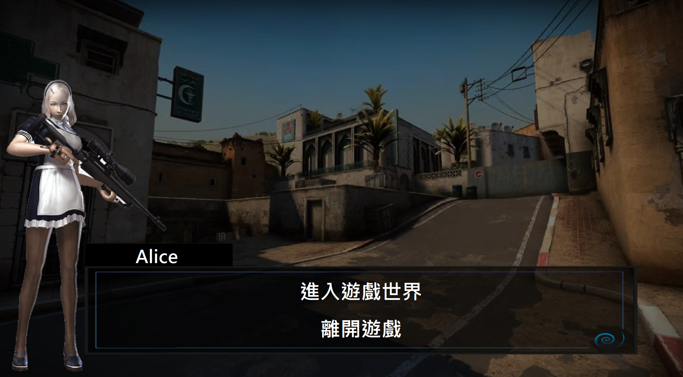
Exit the game
Get into operation page

Slide 10
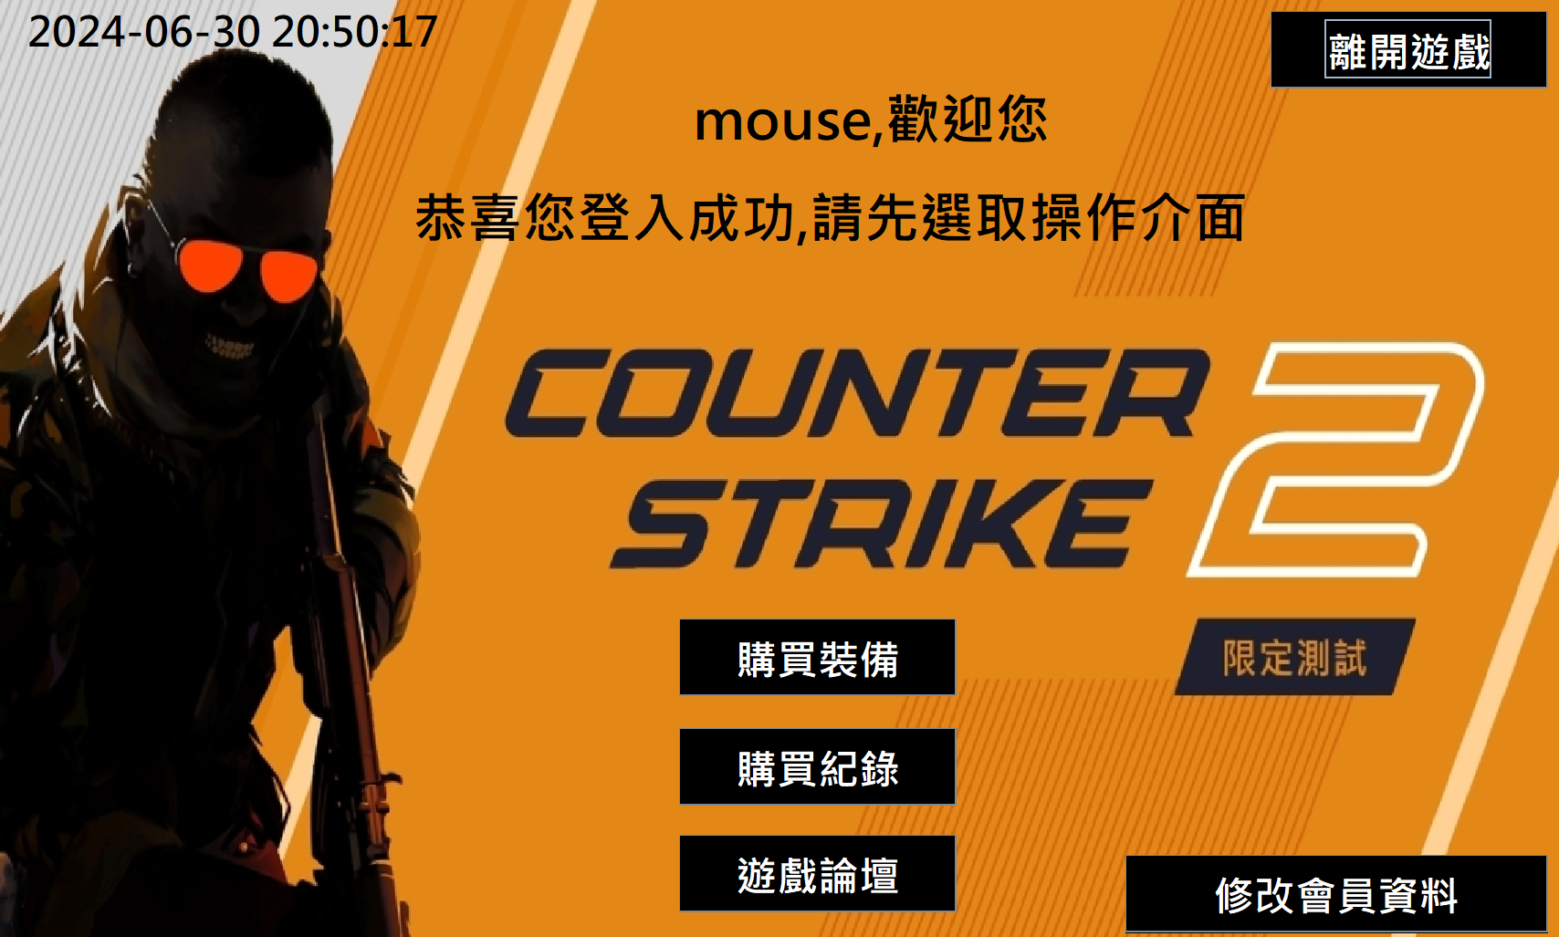
Equipment purchase history
Change players info
Click here you could experience our loot-boxes system and our equipment shop.
Forum of this game

Slide 11
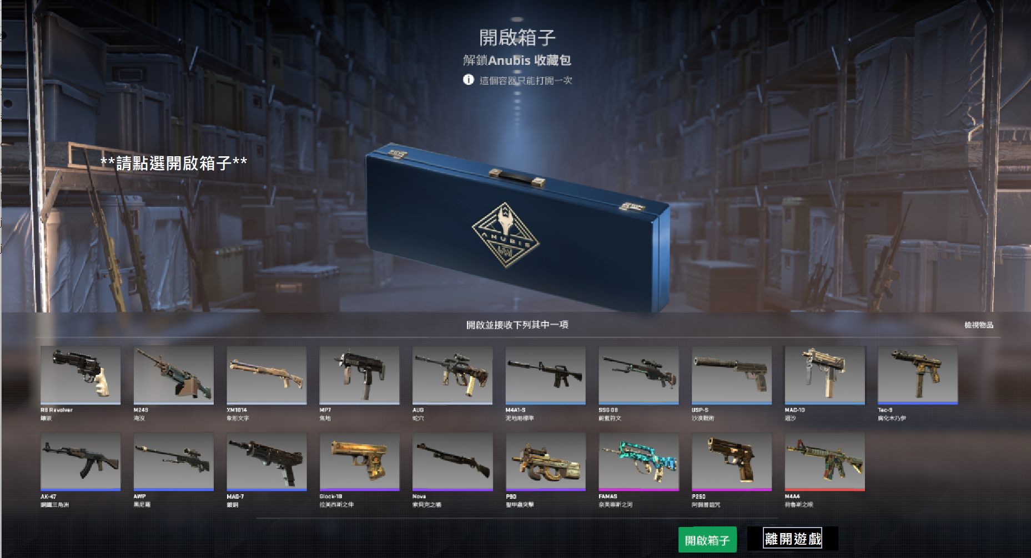
Here’s our loot-box system!
Pls press the button ” open box(開啟箱子)” to start.

Slide 12
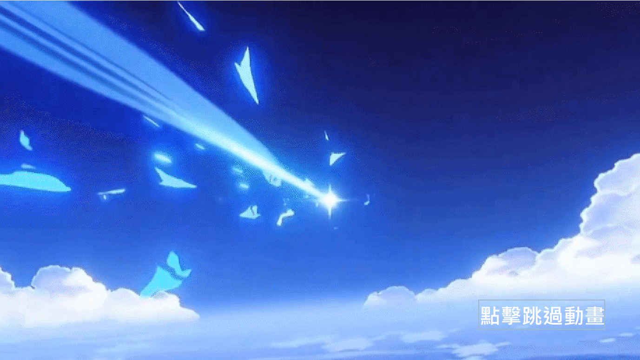
Click here to skip animation

Slide 13
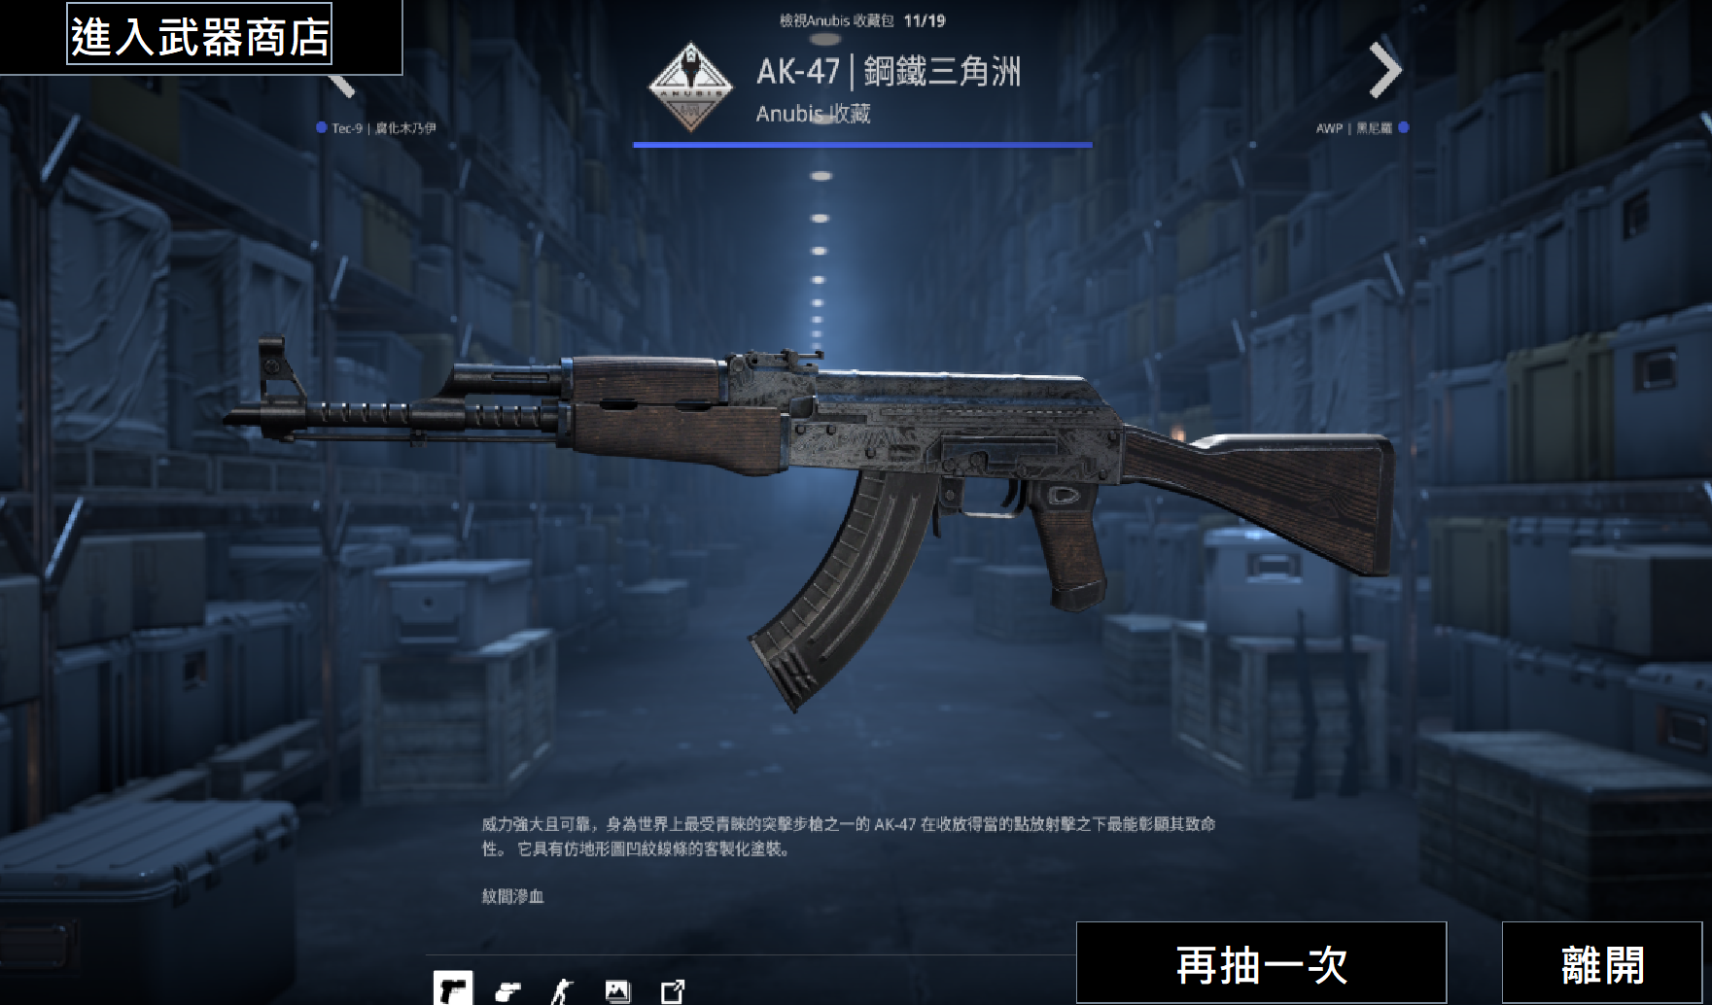
Get into our
Equipment Shop!
Experience loot-box system one more time
Exit

Slide 14
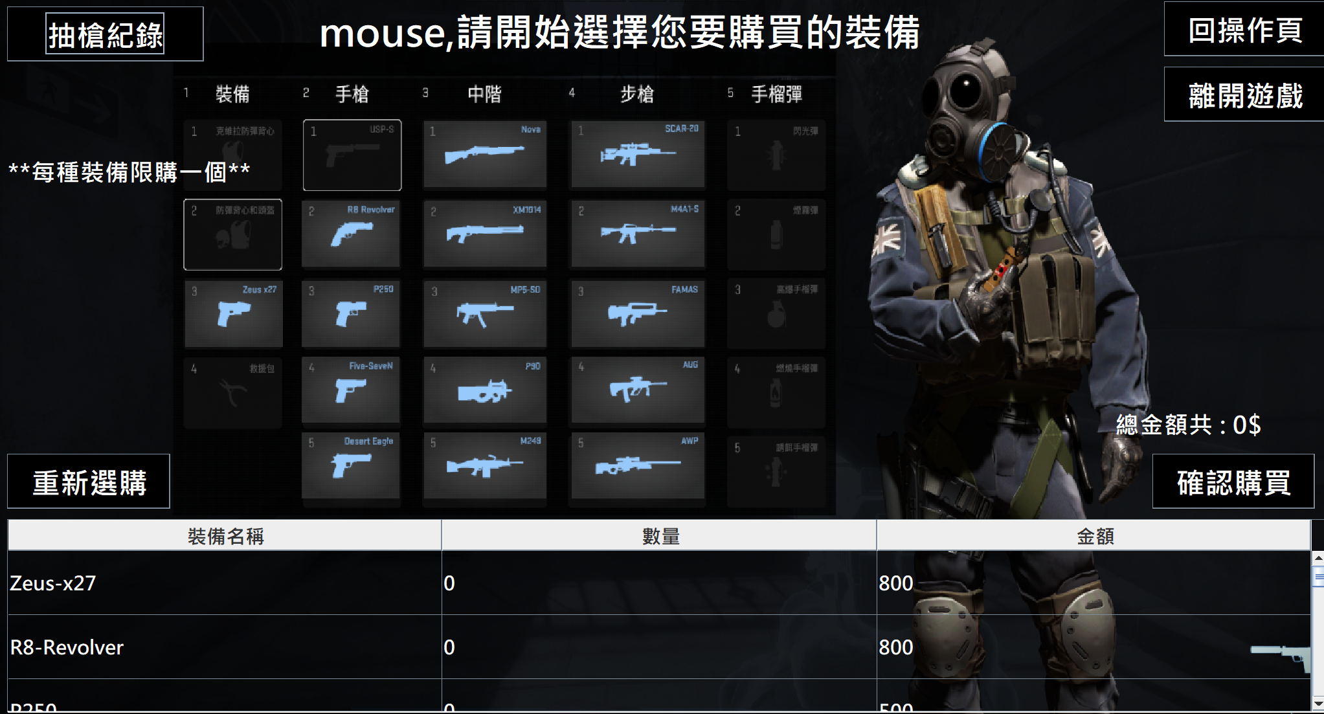
History of loot-box system.
Choose any of the
icons to add an item to shopping cart.
Confirm to purchase
Reset shopping cart
Here’s the shopping cart

Slide 15
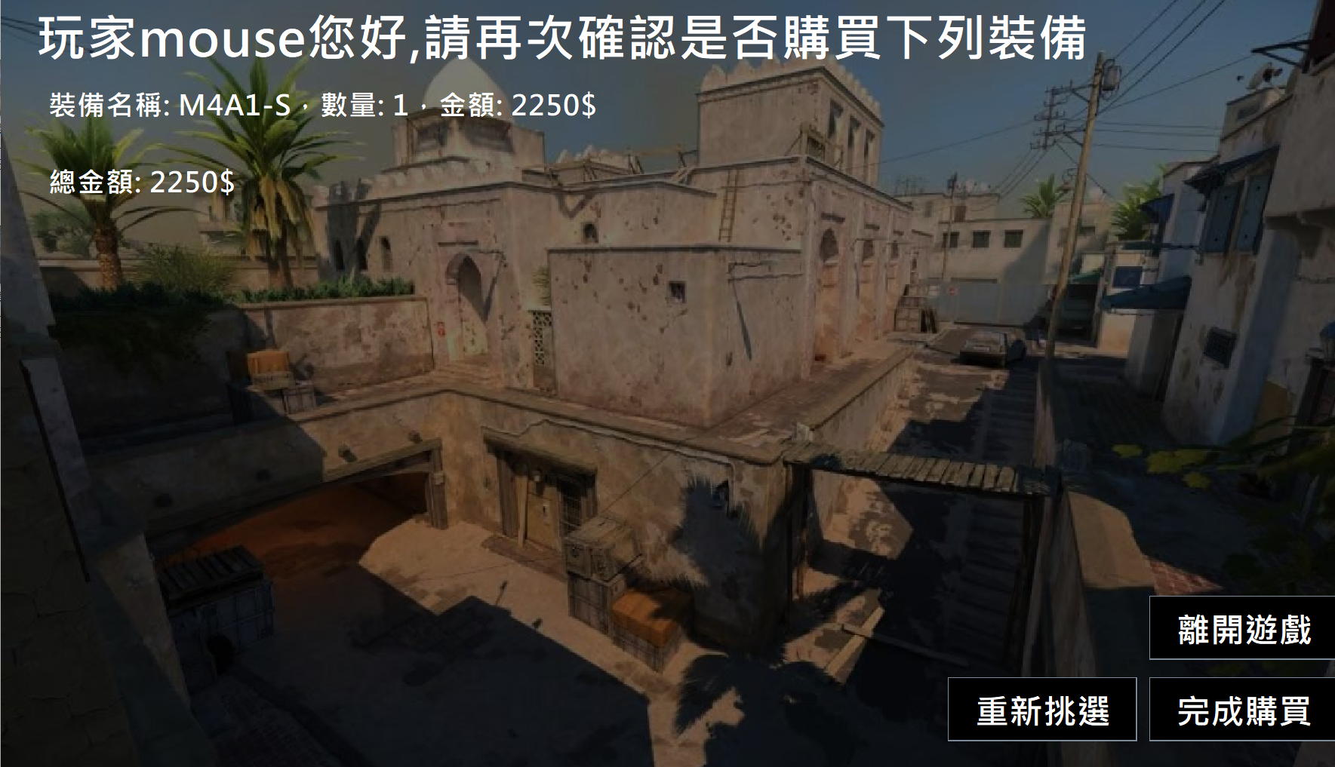
Exit
Sent to purchase
This page allows you to review the items you would like to purchase one more time.
Back to items page

Slide 16
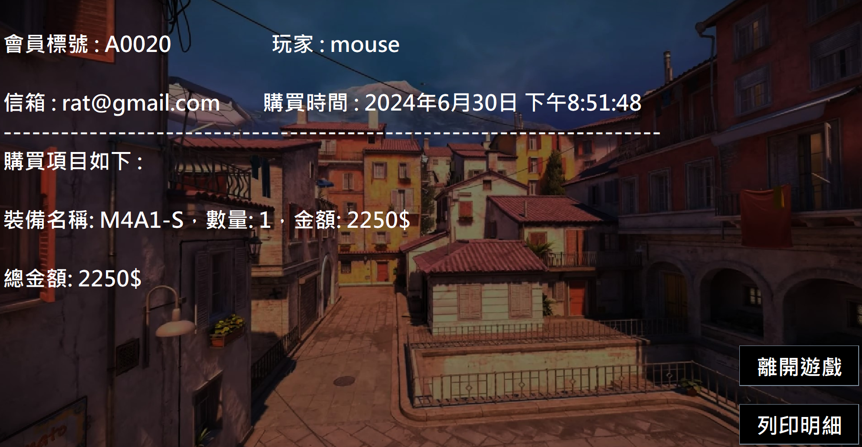
Exit
Print the receipt out

Slide 17
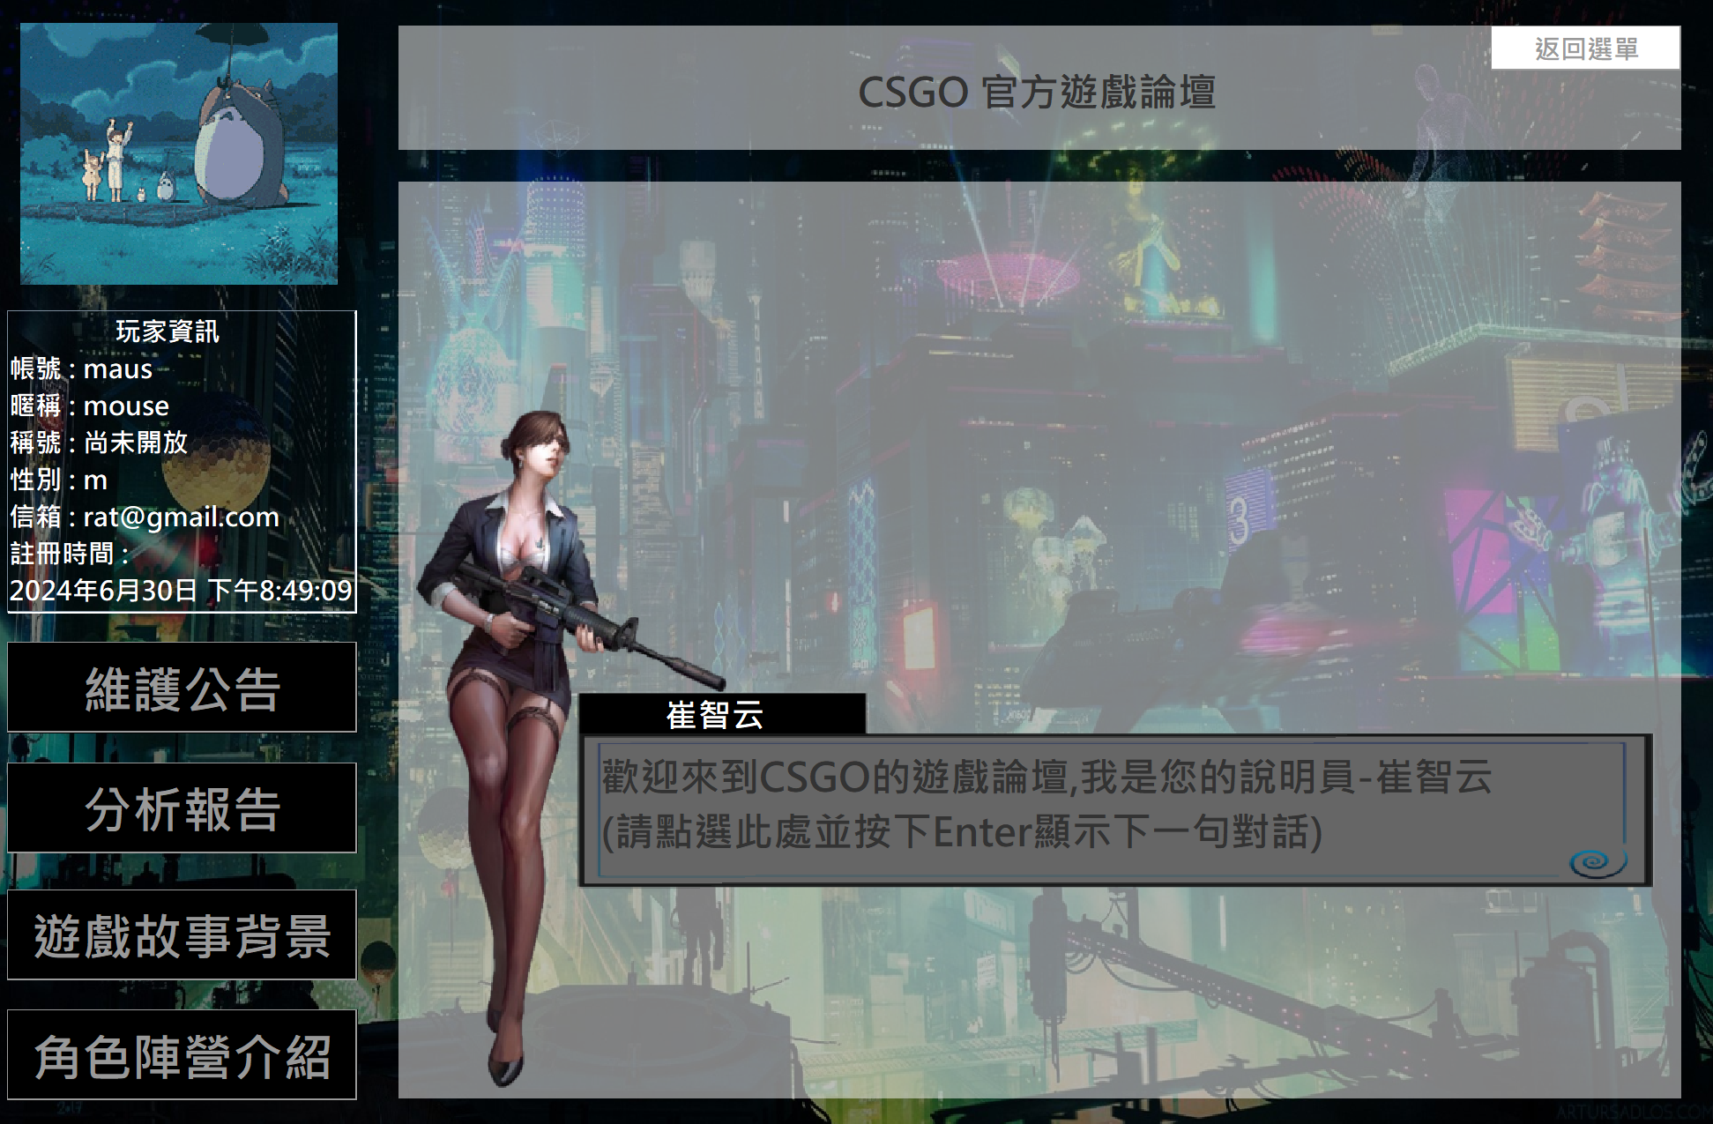
Click here first to see what the commentator says!
Only after the communication, you can start exploring.
After printing the receipt, you will be brought to the game forum. The third commentator in the forum will guide you on how to explore it.

